Slide 1
Autonomous Path Planning for Unmanned Aerial Vehicles
Mihir Kulkarni (2016A4TS0150G) - Lead
Srisreyas S (2017A7PS0065G)
Shivangi Gupta (2018A8PS0026G)
Aditya Bidwai (2018AAPS0388G)
Vishal Singh (2018AAPS0562G)

Slide 2
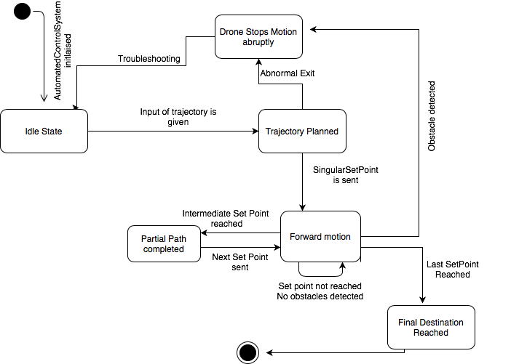
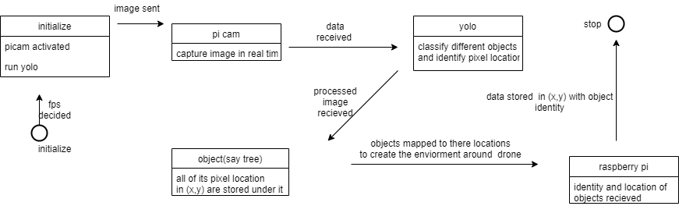
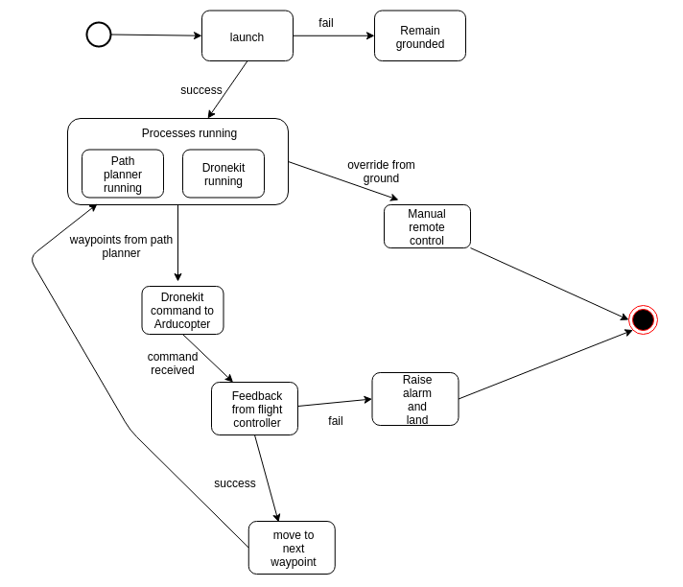
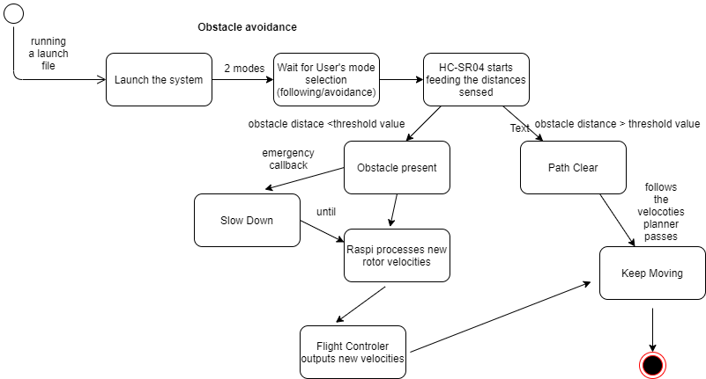
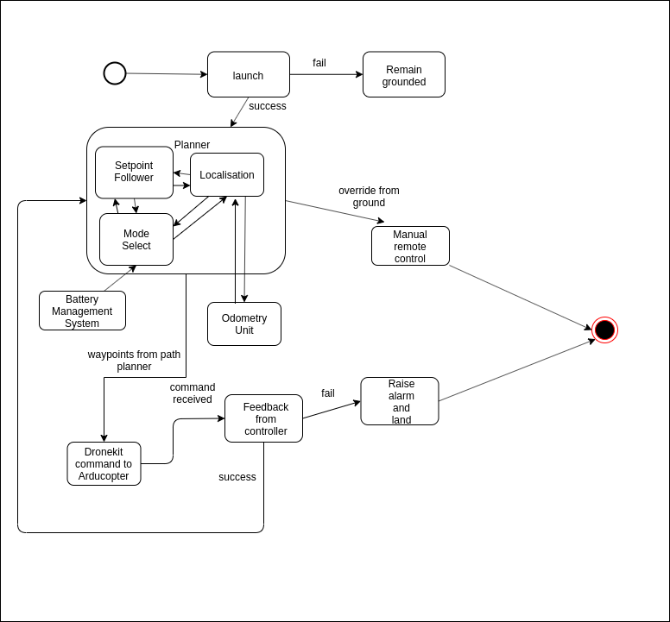
Statechart diagram - Group

Slide 3
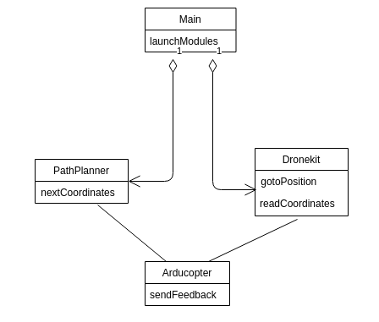
Class Diagram - High Level Controller (Srisreyas S)

Slide 4
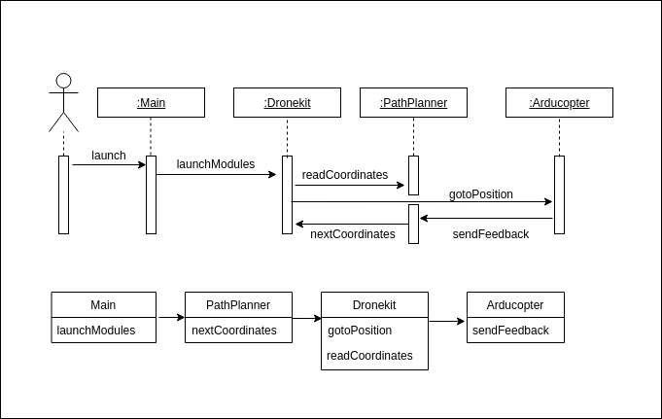
Sequence Diagram - High Level Controller (Srisreyas S)

Slide 5
Statechart Diagram - High Level Controller (Srisreyas S)

Slide 6
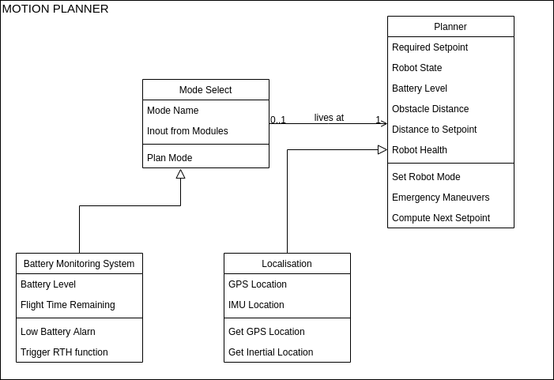
Class Diagram - Mihir Kulkarni

Slide 7
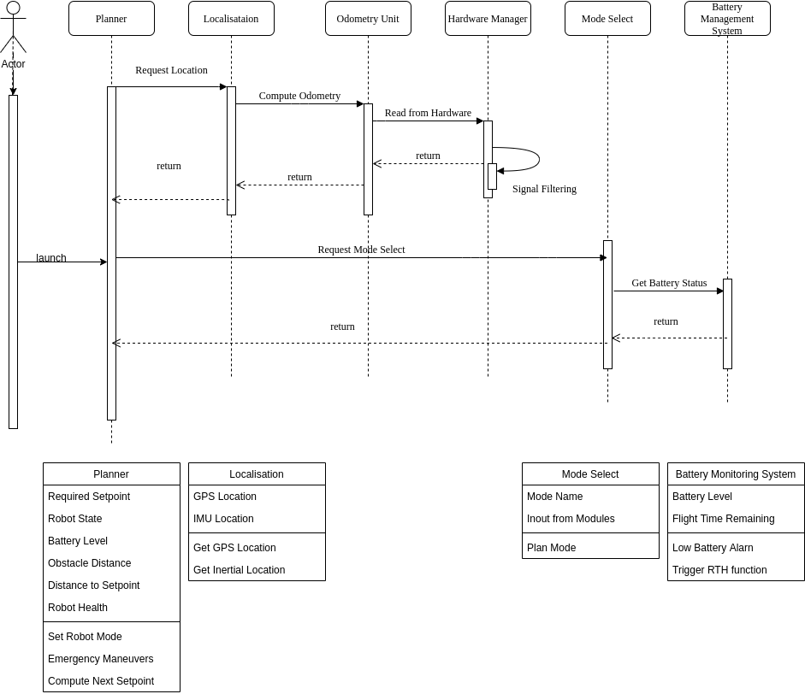
Sequence Diagram - Mihir Kulkarni

Slide 8
Statechart Diagram - Mihir Kulkarni

Slide 9
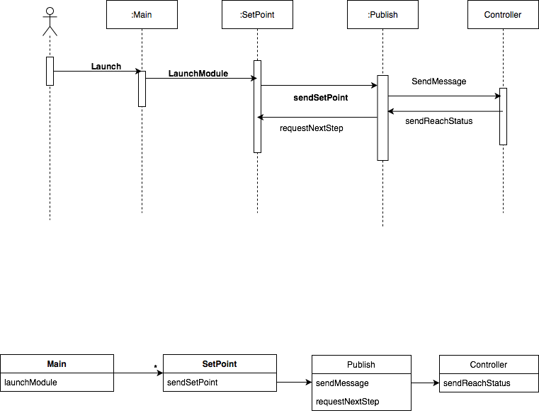
Sequence Diagram - Automation of Drone (Shivangi Gupta)
Class diagram

Slide 10
StateChart Diagram of Drone Automation (Shivangi Gupta)

Slide 11
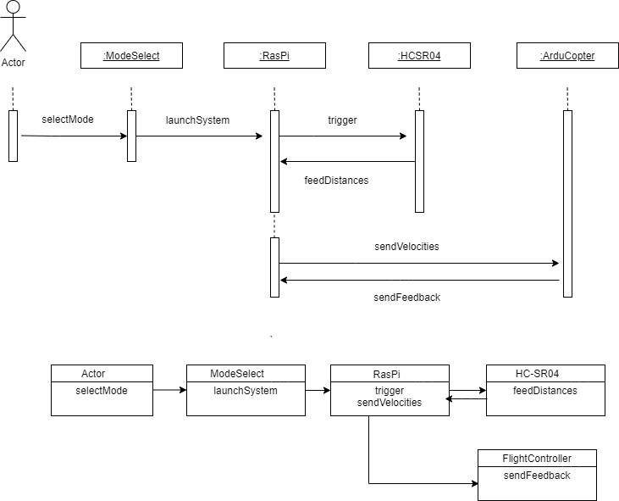
Obstacle Avoidance/Detection using Ultrasonic sensor (Aditya)

Slide 12
State Chart Diagram for Obstacle Avoidance system (Aditya)

Slide 13
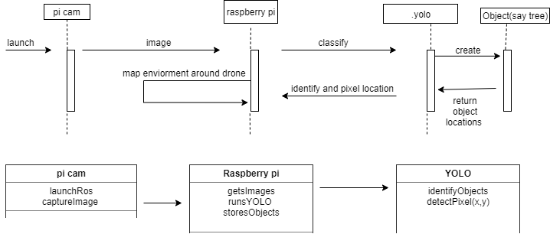
Object Detection using YOLO algorithm (Vishal)
Sequence and class diagrams

Slide 14
Statechart Diagram - Object detection (Vishal)

Slide 15
Rebuttals of Criticisms (Submission 1)
G2, G5 The pose of the user is fully visible when a fisheye lens is used. The pose can be transformed correctly given the lens characteristics.
G3, H5 Unstructured environments without consistent lines or edges, as well as turns, are accounted for by the rotary encoders in the wheels.
G4 OpenPose is a real-time machine-learning based posture detection system and not a generalization. All machine learning models can be further trained based on requirement.
H2, H3 Raspberry Pi is currently the cheapest general-purpose companion computer for embedded systems and robotics, costing a little over 3000 Rupees. It is capable of running ROS as well as deep learning frameworks and drone autopilots, and the algorithms and models used in our system can run on it in real-time.

Slide 16
Comments on Submission 2
G2 A training dataset size of 100 is too small for a deep neural network and will lead to overfitting. Additionally, use cases require to explicitly specify actions by the user and the system, which was not done in this case.
G3 Multiple use cases mention the need for the patient to connect sensors to himself/herself, which is not practical in old and/or bedridden people. Frequency of internet backup of ECG data not mentioned. The bifurcation of user and system actions in separate columns as discussed in class is not followed.
G4 The heavy requirement for the patient to use a smartphone is impractical for a quadriplegic, and such a scenario would require them to be assisted by their caretakers even for the simplest of talks, undoing the purpose of smartphone control. The bifurcation of user and system actions in separate columns as discussed in class is not followed.
G5, H2 GPS often fails indoors and in poor weather. Additionally, buzzers are impractical when the patient is hard of hearing. The bifurcation of user and system actions in separate columns as discussed in class is not followed.
H1 Traditional BP monitor wrist cuffs do not detect placement. Additionally, local storage carries the risk of data loss. The bifurcation of user and system actions in separate columns as discussed in class is not followed.

Slide 17
Comments on Submission 2 (contd.)
H3 Bluetooth has limited range and a very low data transfer speed. GPS often fails indoors and in poor weather. Additionally, use cases require to explicitly specify actions by the user and the system, which was not done in this case. GSM may not be the best option in a situation with low battery due to mobile data transmission’s high power consumption.
H4 Data transmission destination (mobile/PC/cloud) not mentioned. GPS often fails indoors and in poor weather. The bifurcation of user and system actions in separate columns as discussed in class is not followed.
H5 Google Maps is not accurate to the last meter at all times, and is often inaccurate in remote areas and in absence of a good GPS signal. An SVM may not be the optimal way to provide real-time classification, especially on image/video data, and is also incapable of localising the classified object. The bifurcation of user and system actions in separate columns as discussed in class is not followed.

